Slide 1
MALIGNANT COMMENTS CLASSIFICATION PROJECT
Submitted By:
Milind B. Kuwar

Slide 2
Problem Statement
Sentiment Analysis is the task of analyzing people’s opinions in textual data (e.g., product reviews, movie reviews, or tweets), and extracting their polarity and viewpoint. The task can be cast as either a binary or a multi-class problem. Binary sentiment analysis classifies texts into positive and negative classes, while multi-class sentiment analysis classifies texts into fine-grained labels or multi-level intensities.
The goal of this project is to use deep learning techniques to identify the level toxicity of a comment which could be used to help deter users from posting potentially hurtful comments, engage in more sophisticated arguments and make internet a safer place.

Slide 3
Dataset Exploration
Project contain train and test dataset.
In train data set there are 159,571 rows and 8 columns.
In test data set it is like 153,164 rows and 2 columns.
There are no null values in the dataset
Most of the data are numeric in nature which are binary.
Comments is object in nature and consist of text.
Overall memory usage for train and test is around 15MB.

Slide 4
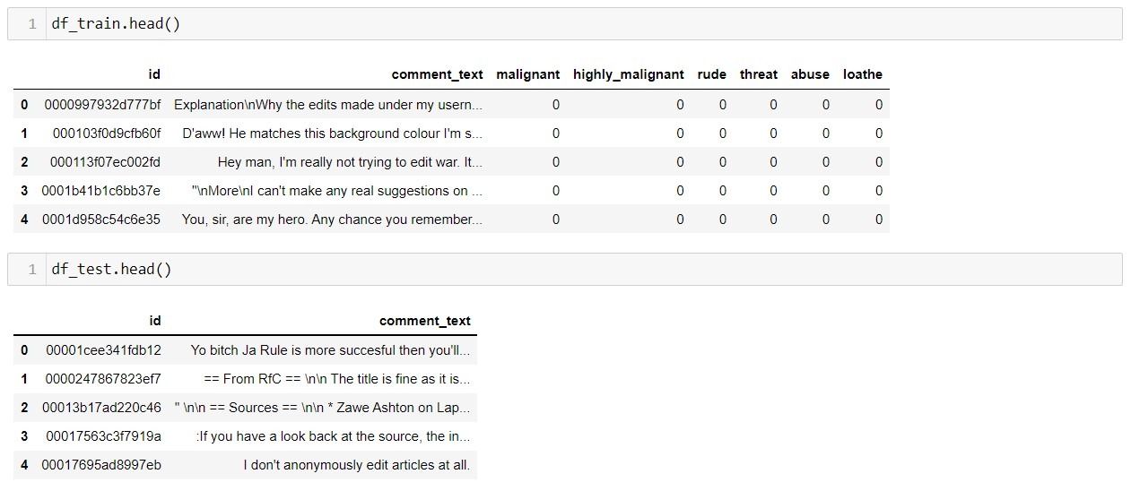
Exploratory Data Analysis

Slide 5
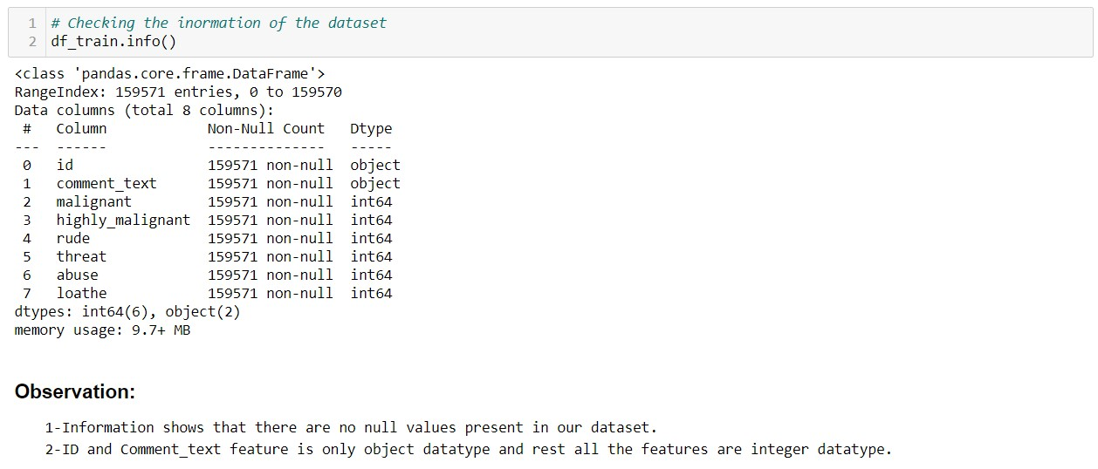
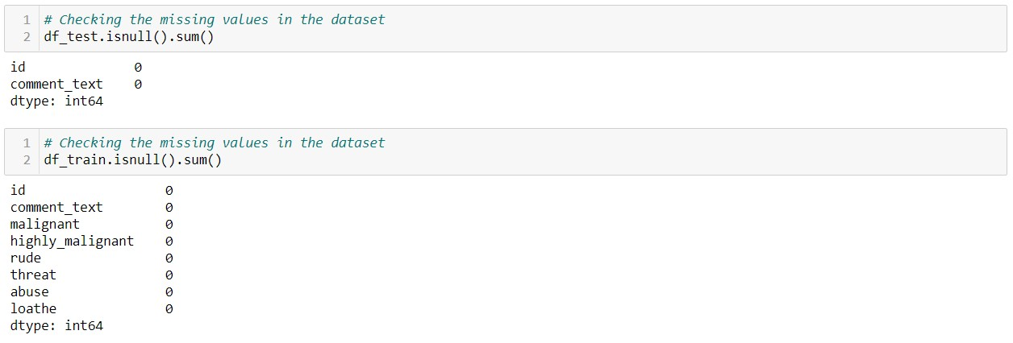
Then we further checked more about data using info, checked datatypes using dtypes, shapes using .shape, columns using .columns, null values using .isnull.sum and further visualize it through heatmap as follows:

Slide 6
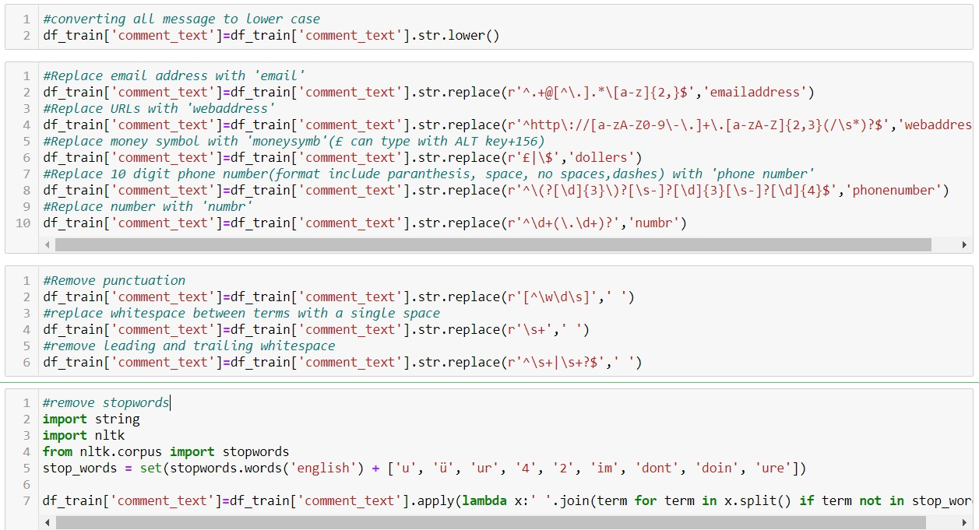
Data Preprocessing
As there are no null values in the dataset, but as the comment column in text format hence it requires pre processing.

Slide 7
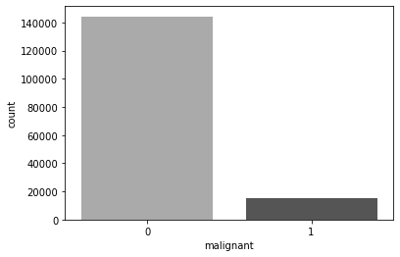
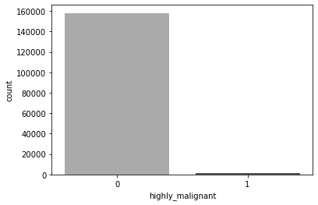
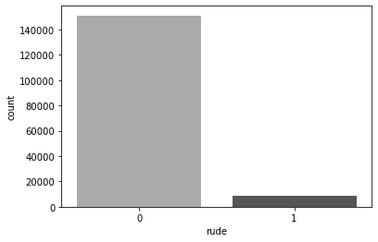
Data Visualization

Slide 8
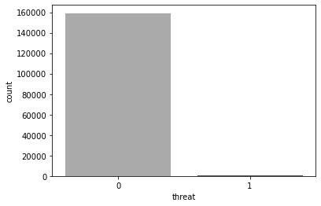
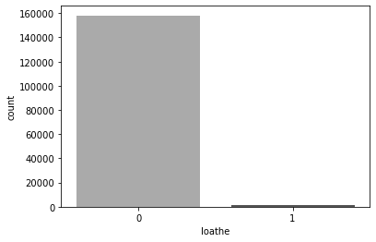
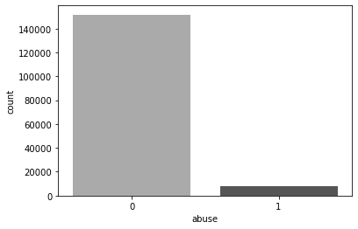

Slide 9
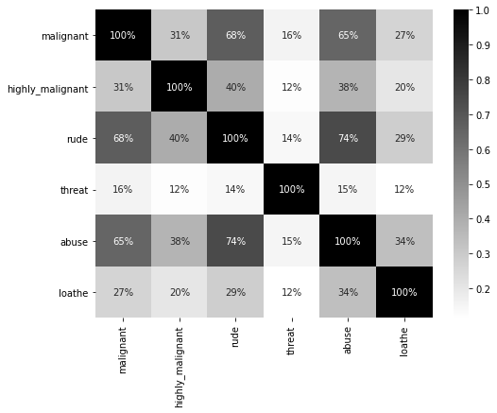

Slide 10
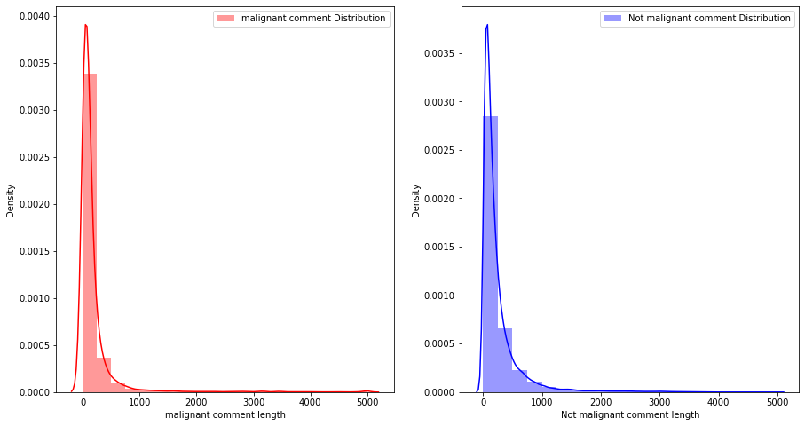
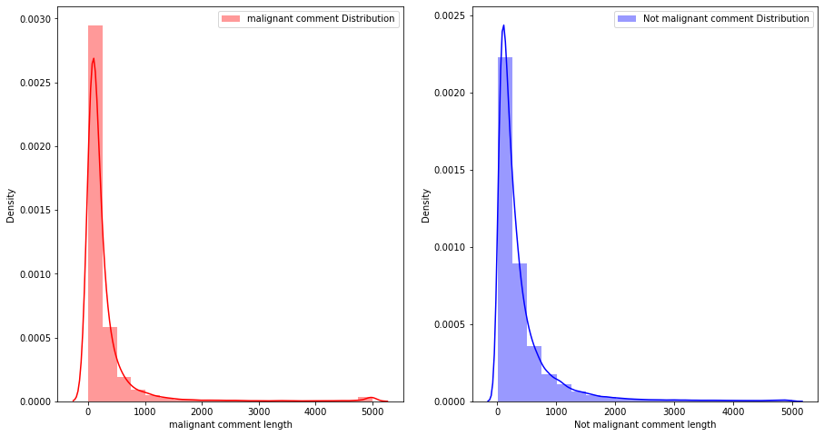

Slide 11

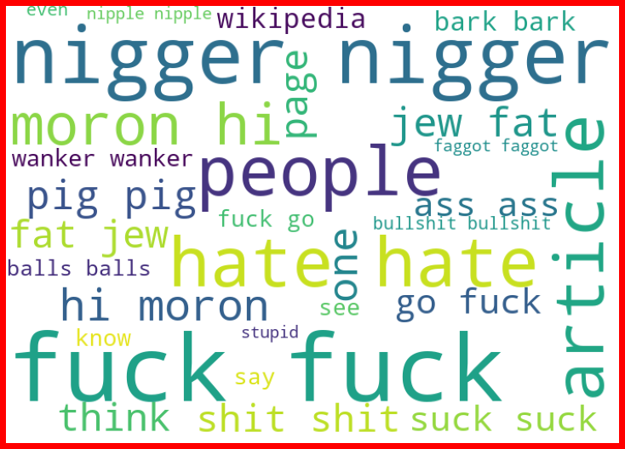

Slide 12
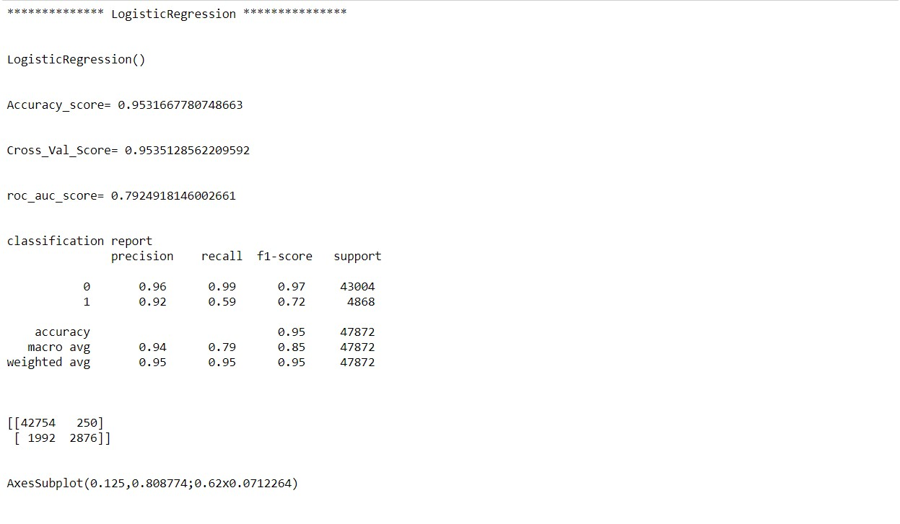
Model Training
Logistic Regression

Slide 13
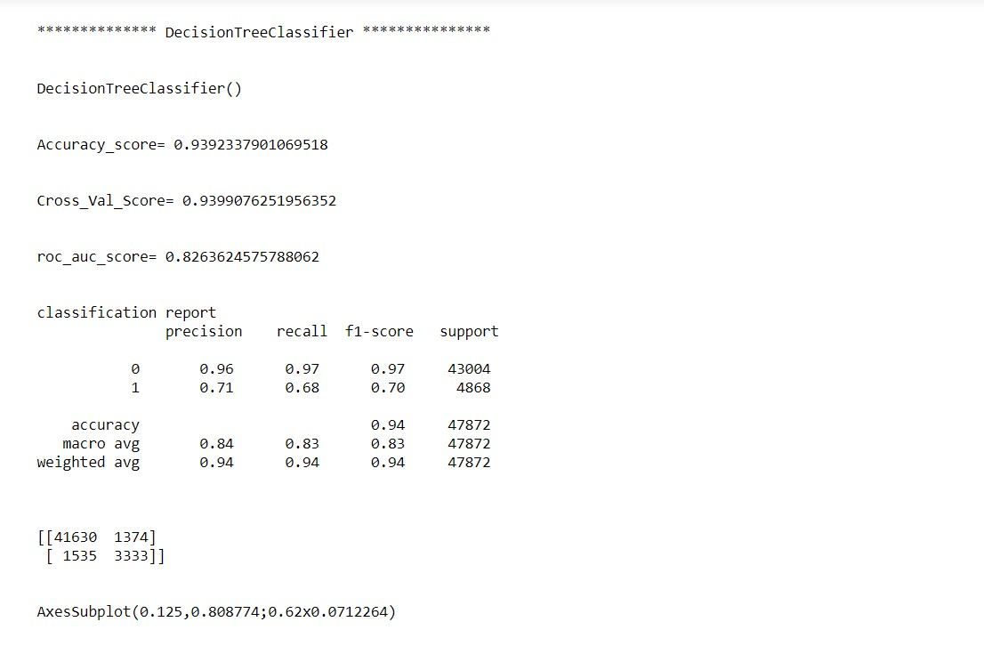
Decision Tree Classifier

Slide 14
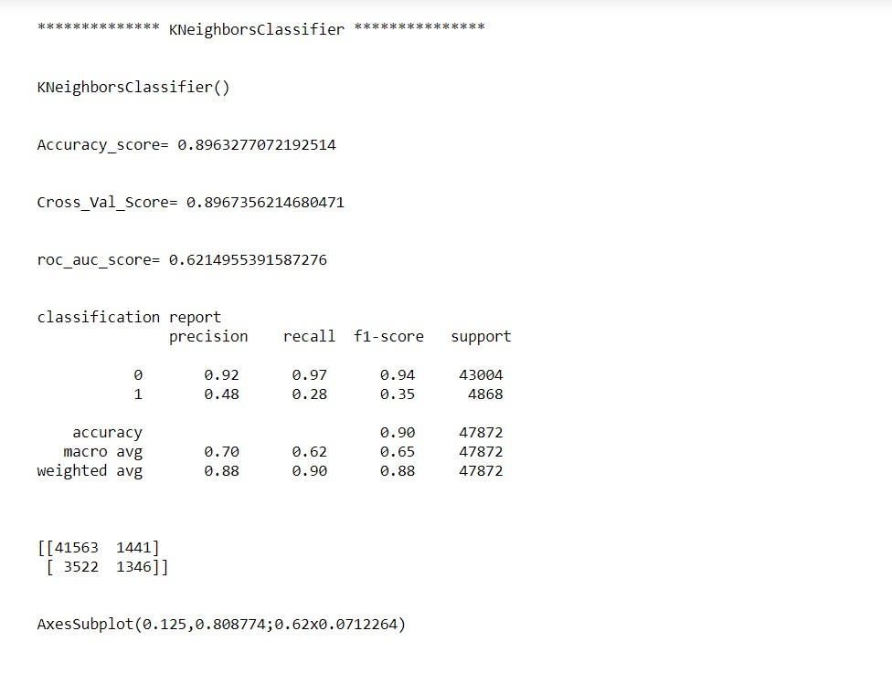
Kneighbours Classifier

Slide 15
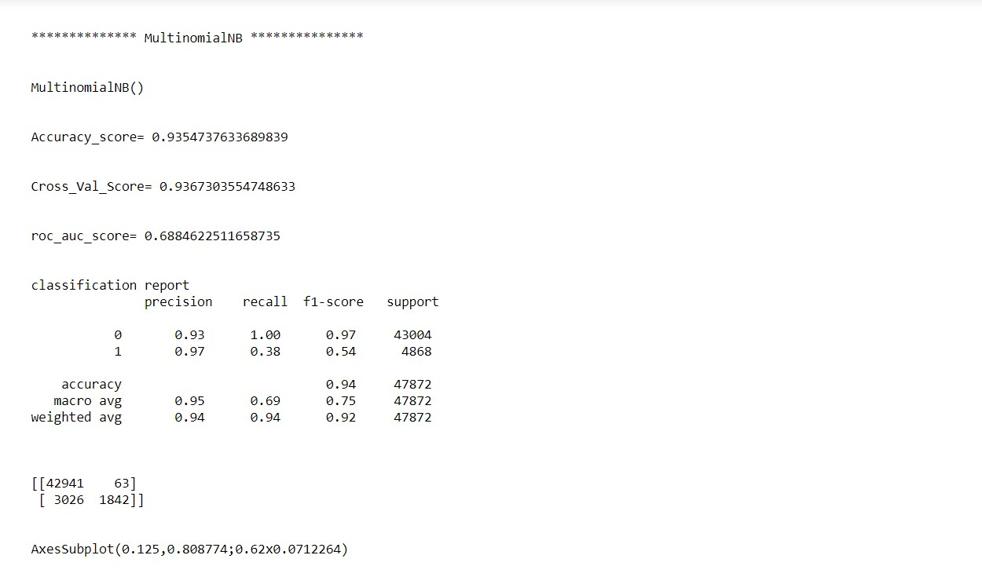
MultinominalNB

Slide 16
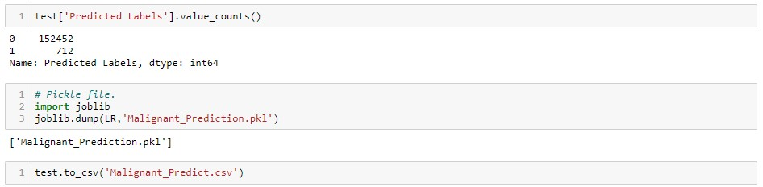
Saving The Model

Slide 17
Conclusion
We have got Logistic Regression as best model since it’s giving us good result and other metrics are also satisfactory.
Using Logistic Regression as our final algorithm we have predicted the values for test dataset and it’s also working well and is able to differentiate/predict negative comments and non-negative (good) comments.
From displaying the data, it seems there is lot of special characters present in the data. So, it is better to proceed by filter it out.
As the above data is in text, so presence of special characters and stopwords is always there.
After proper cleaning and processing, decision tree classifier gives the highest accuracy as well as ROC Score.

